Slide 1
How to learn Excel VBA Macros
Version: 05-Apr-2018

Slide 2
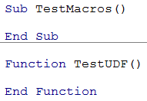
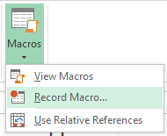

Record Macros
Searching Google for codes
Write Codes
✓
✓
✓

Slide 3
Record Macros
Searching Google for codes
Write Codes
✓
✓
✓

Slide 4
3 magic words…
“VBA code to…”

Slide 5
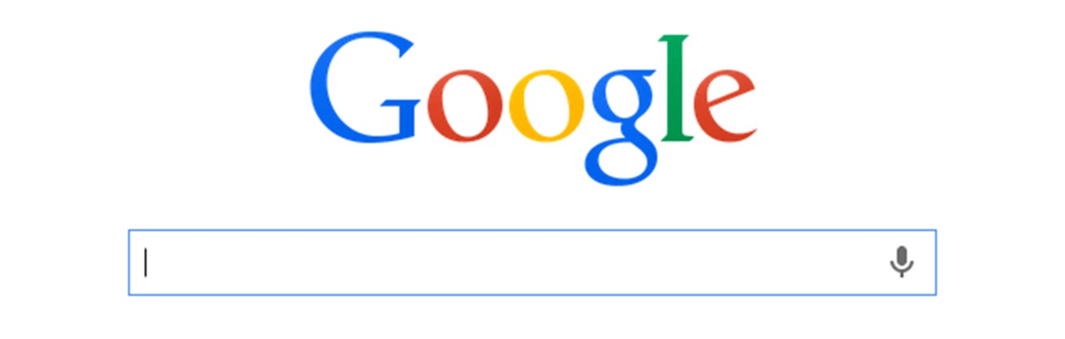

Slide 6
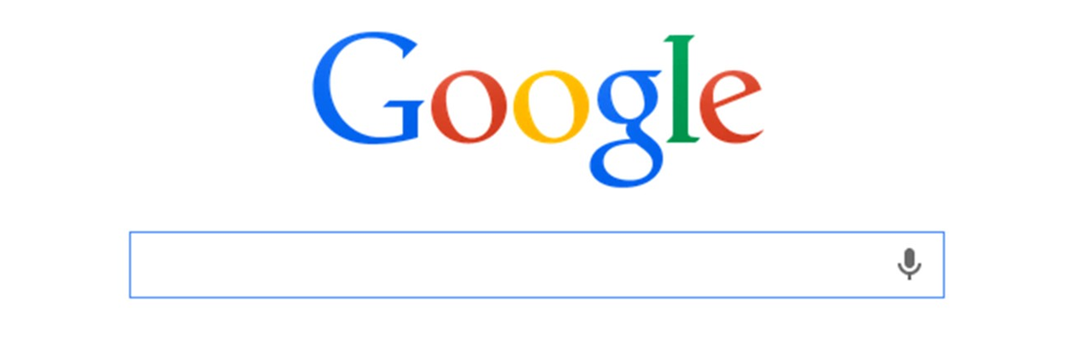
vba code to
[task to achieve]

Slide 7
vba code to
[verb]
[object]
[addl. logic]

Slide 8
vba code to
split table by columns

Slide 9
vba code to
convert numbers in words rupees

Slide 10
vba code to
combine multiple workbooks

Slide 11
Let’s see how it works…

Slide 12
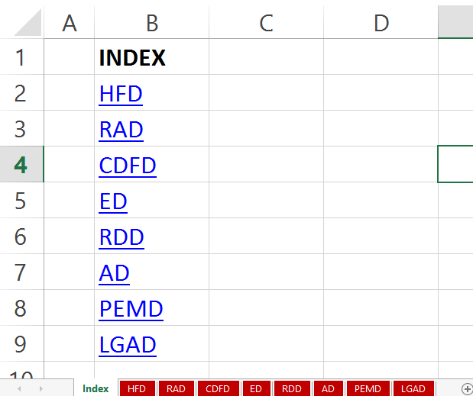
#1
create index of links to worksheets

Slide 13
#1
create index of links to worksheets

Slide 14
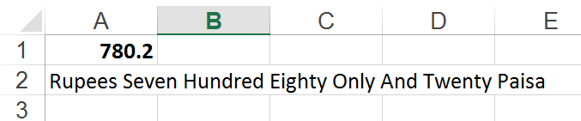
#2
convert numbers in words rupees

Slide 15
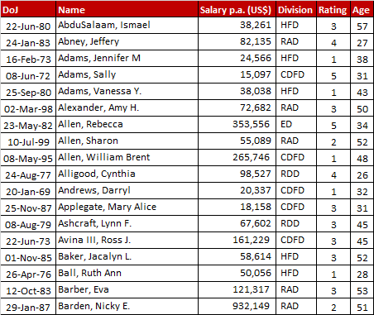
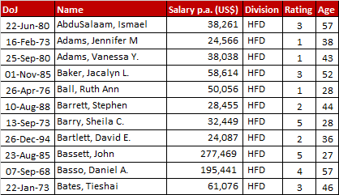
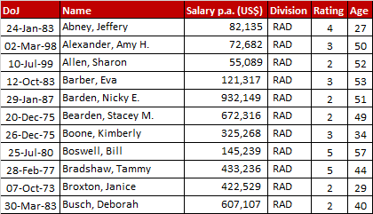
#3
split table by column
…

